Slide 1
streaming system - streaming model
The reading notes of 云尘
BOOK: Streaming Systems
by Tyler Akidau, Slava Chernyak, and Reuven Lax

Slide 2
Flink
流式系统理论及设计，基于streaming system这本书来理解
基于上面的设计理论思想来理解Flink的基础概念
然后逐步深入掌握Flink streaming（基于kafka）的编程设计
在上面的基础之上逐步深入Flink源码（执行流程、akka通讯、connect..）
然后深入某一个模块，理解其设计并融入社区成为commiter

Slide 3
Streaming Foundation Concept
Watermarks
Advanced Windowing
Exactly-once

Slide 4
Streaming Foundation Concept
Streaming 101
Streaming 102
A high-level tour of modern data-processing concepts
The what, where, when, and how of unbounded data processing
Notes:
Streaming 101：主要讲解一些背景信息以及阐述一些基本术语以便深入时间领域及从high-level层次来概述数据处理的常见处理方法，包括batch and streaming

Slide 5
Streaming 101
Background
What is streaming?
Batch to streaming evolution
Event time vs. processing time
Data processing patterns
Unbounded data — batch
Unbounded data — streaming
Windowing

Slide 6
Streaming 101
Background
What is streaming?
Batch to streaming evolution
Event time vs. processing time
Data processing patterns
Unbounded data — batch
Unbounded data — streaming
Windowing

Slide 7
wath’s streaming
streaming
business-driven
a type of data processing engine that is designed with infinite data sets in mind
Unbounded data vs bounded data
A type of ever-growing, essentially infinite data set
Unbounded data processing
An ongoing mode of data processing
Low-latency, approximate, and/or inaccurate/speculative results
低延迟、近似和/或不精确/推测的结果
infinite “streaming” data sets
finite “batch” data sets
一个不间断进行的数据处理方式
Lambda Architecture

Slide 8
batch to streaming evolution
Lambda Architecture
run a streaming system alongside a batch system
Questioning the Lambda Architecture
Kappa Architecture
running a single pipeline using a well-designed system
Flink： all-streaming-all-the-time
how to well-designed streaming systems？
Correctness
Tools for reasoning about time
strong consistency、semantic、checkpoint …
Notes:
我认为设计良好的流媒体系统实际上提供了一组严格的批处理功能
Correctness — This gets you parity with batch.做到了正确性就能等同于batch system，参考spark论文
Tools for reasoning about time — This gets you beyond batch.做到了这点就等于打败了batch system
对于处理具有不同事件时间偏差的无界、无序数据，Good tools for reasoning about time是必不可少的

Slide 9
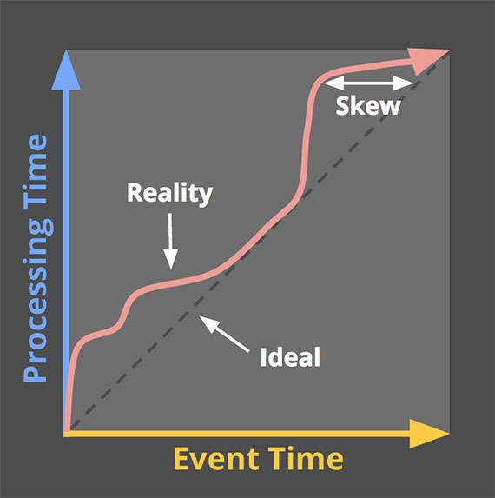
Event time vs processing time
Event time
Ingestion time
Processing time
skew between processing time and event time
Notes:
要准确地描述unbounded data processing，需要清楚地理解所涉及的time domains
Not all use cases care about event times (and if yours doesn’t, hooray! — your life is easier)
然而，事实并非如此，事件时间和处理时间之间的偏差不仅是非零的，而且会随着input sources, execution engine, and hardware不同而高度变化的

Slide 10
Streaming 101
Background
What is streaming?
Batch to streaming evolution
Event time vs. processing time
Data processing patterns
Unbounded data — batch
Unbounded data — streaming
Windowing

Slide 11
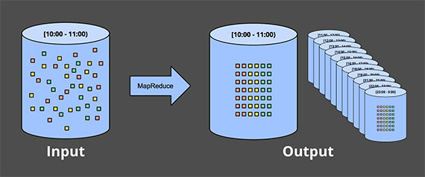
Unbounded data — batch
Unbounded data into a collection of bounded data set
Fixed windows
however, most systems still have a completeness problem to deal with
What if some of your events are delayed?
Notes:
批处理引擎虽然在设计时没有明确考虑到无界数据，但自从第一次构思批处理系统以来，就被用于处理无界数据集。 正如人们可能预期的那样，这种方法将无界数据分割成适合批处理的有界数据集的集合

Slide 12
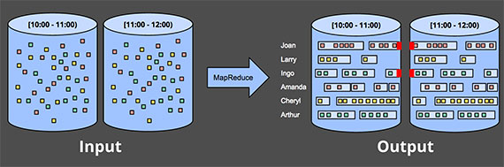
Unbounded data — batch
Sessions
increasing batch sizes
increased latency
add additional logic
complexity
Notes:
Sessions通常定义为活动周期(例如，对于特定用户)，以不活跃的间隙结束。 在使用典型的批处理引擎计算 Sessions时，Sessions通常会被不同的批次所分割

Slide 13
Unbounded data — streaming
Highly unordered with respect to event times
Of varying event time skew
categorize
Time-agnostic
Approximation algorithms
Windowing by processing time
Windowing by event time

Slide 14
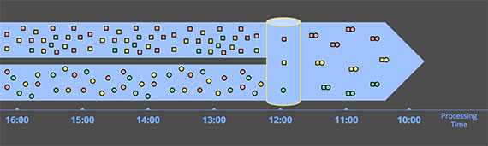
Unbounded data — streaming
Time-agnostic
all relevant logic is data driven
Batch ~= Streaming
Filtering
Web traffic logs
unbounded, unordered, skew is irrelevant
Inner-joins
only care about the results of a join when an element from both sources arrive, there’s no temporal element to the logic

Slide 15
Unbounded data — streaming
Approximation algorithms
we want the answer real time as soon as the data is available
the answer does need to be exact
Realtime Trending Analysis
Top-N: Top 5 videos watched in last 2 hours
Top-N: Top 10 news stories browsed in last 15 minutes
streaming K-means

Slide 16
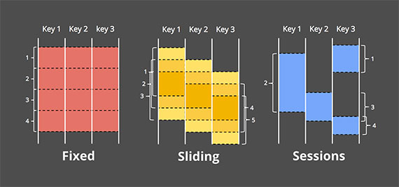
Unbounded data — streaming
Windowing Foundation
Fixed windows
a fixed-size temporal length
Sliding windows
a fixed length and a fixed period
Sessions
analyzing user behavior

Slide 17
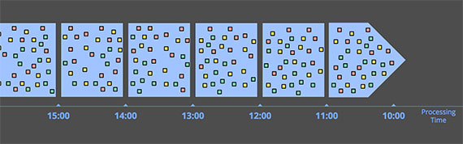
Unbounded data — streaming
Windowing by processing time
Simple
Judging window completeness is straightforward
infer information about the source as it is observed
Many monitoring scenarios fall into this category
tracking the number of requests per second
Notes:
如果你想要根据观察到的数据来推断某些信息，processing time窗口正式你所需要的， 许多监控场景都属于这一类。 想象一下，跟踪发送到全球范围的Web服务的每秒请求数

Slide 18
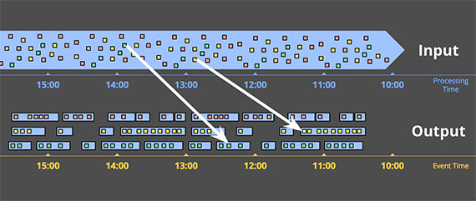
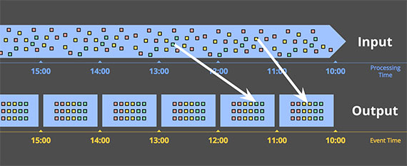
Unbounded data — streaming
Windowing by event time
correctness
create dynamically sized windows, such as sessions
two notable drawbacks
Buffering
Completeness
Notes:
event time窗口是在需要以有限个时间块来观察数据源时使用的窗口，这些数据源反映了这些事件实际发生的时间。 这是划分窗口的黄金标准
well-designed data-processing system with strongly consistent persistent state and a decent in-memory caching layer
many useful aggregations do not require the entire input set to be buffered (e.g., sum, or average)

Slide 19
Streaming 102
Data and Bean/Flink
Batch on unbounded data
Streaming on unbounded data
Notes:
Terminology
batch versus streaming
data processing patterns

Slide 20
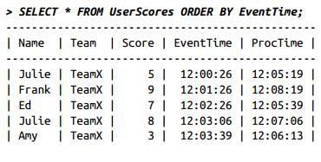
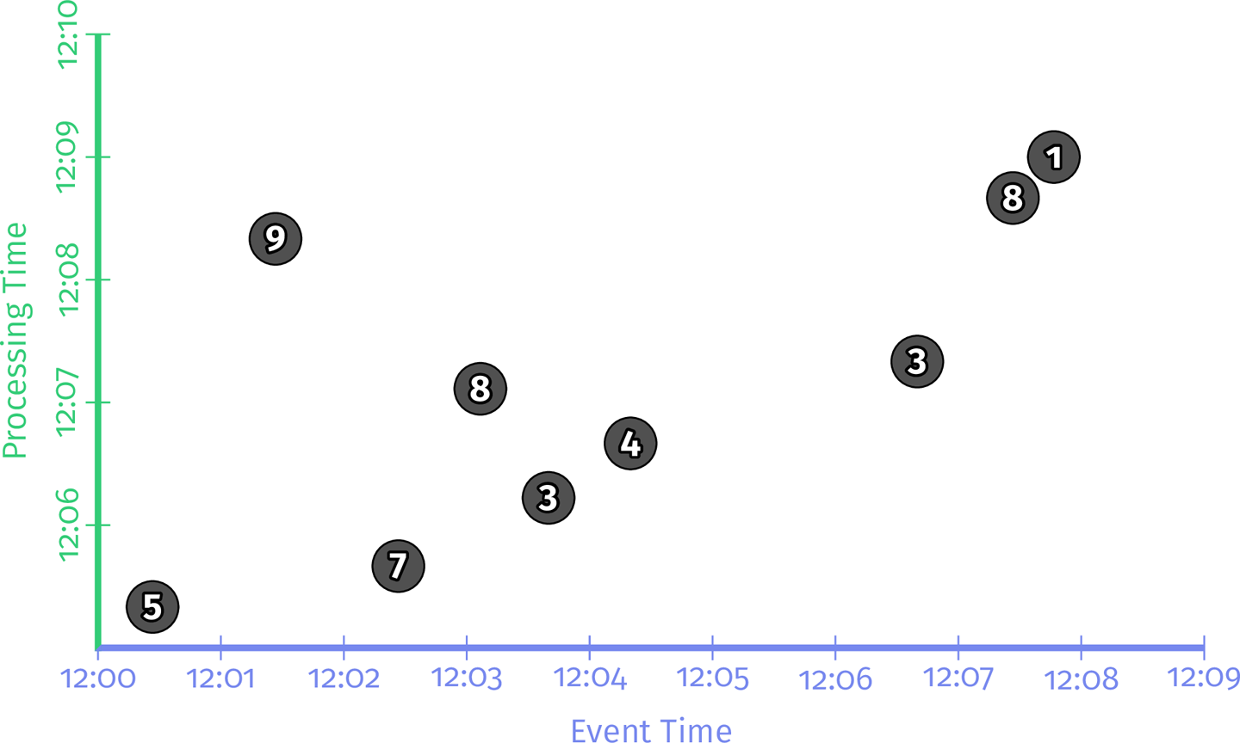
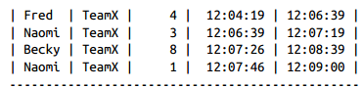
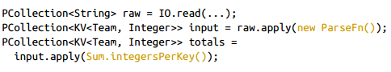
Data and Bean/Flink
Beam
Pcollections
PTransforms

Slide 21
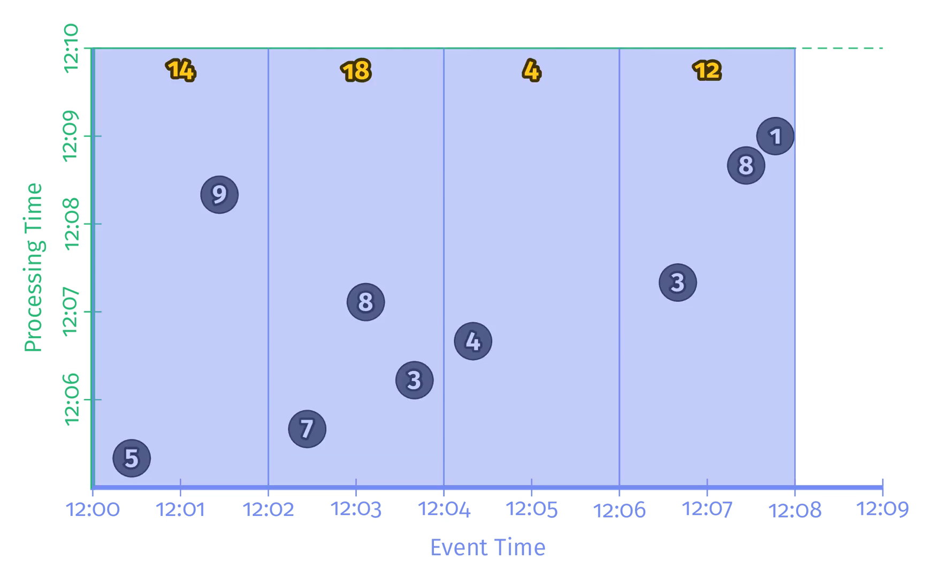
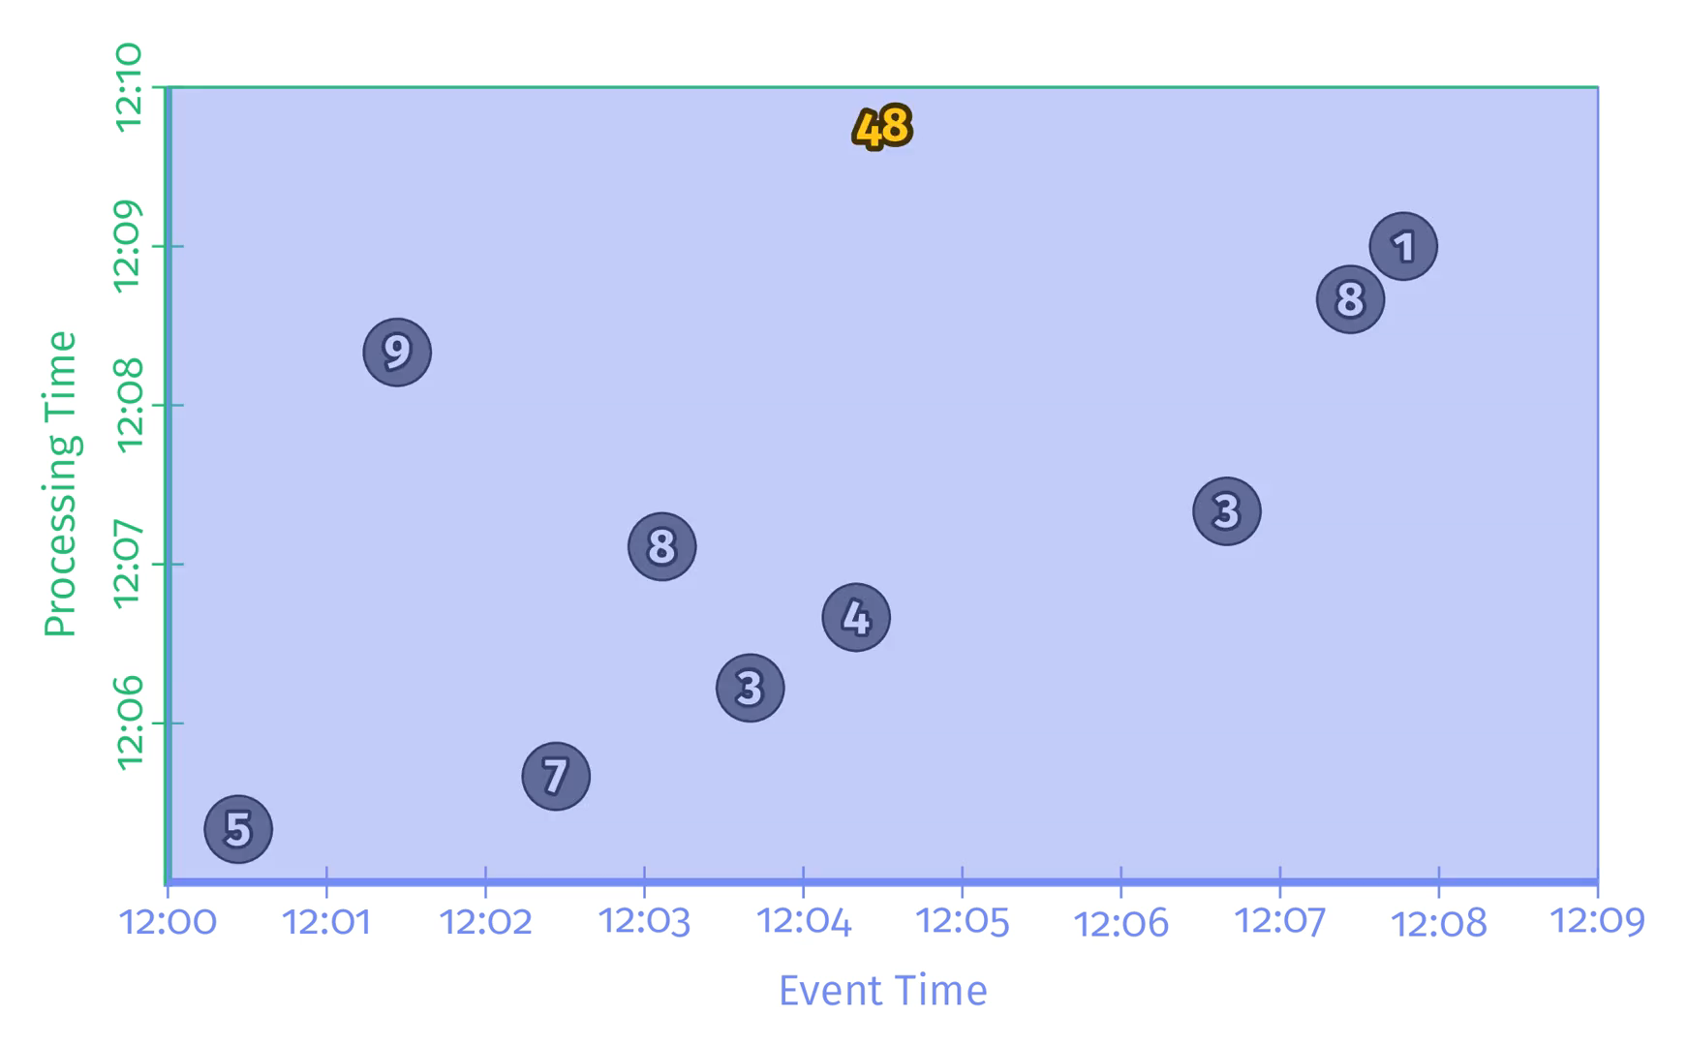
Batch on unbounded data
Compreteness data
PCollection<String> raw = IO.read(...); PCollection<KV<Team, Integer>> input = raw.apply(new ParseFn()); PCollection<KV<Team, Integer>> totals = input.apply(Sum.integersPerKey());
Window
PCollection<KV<Team, Integer>> totals = input .apply(Window.into(FixedWindows.of(TWO_MINUTES))) .apply(Sum.integersPerKey());

Slide 22
Streaming on unbounded data
Triggers
When collecting and grouping data into windows
when to emit the aggregated results of each window
Watermarks
Accumulation

Slide 23
Streaming on unbounded data
How
Completeness: How important is it to have all of your data before you compute your result？
Latency: How long do you want to wait for data? For example, do you wait until you think you have all data?？
Cost: How much compute power/money are you willing to spend to lower the latency？
Ｔwo types of triggers
Repeated update triggers
Completeness/watermark triggers
Notes:
every new record, or they can happen after some processing-time delay, such as once a minute.

Slide 24
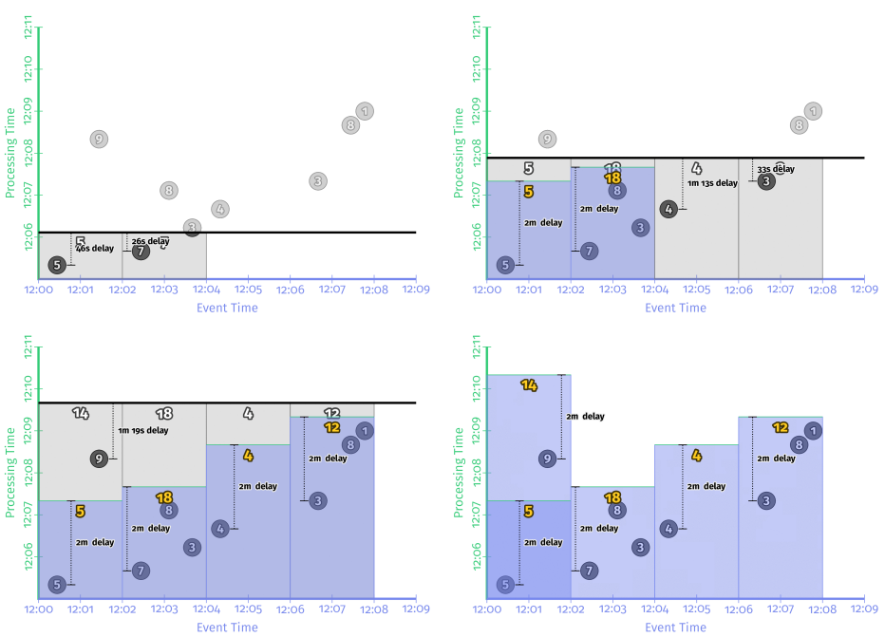
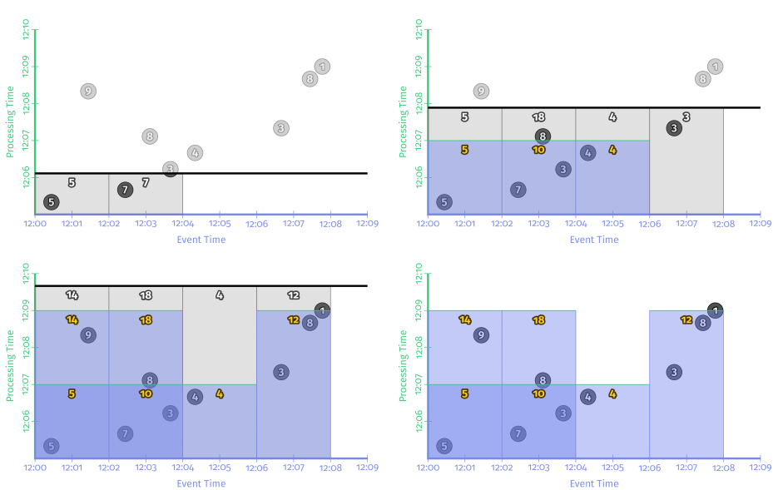
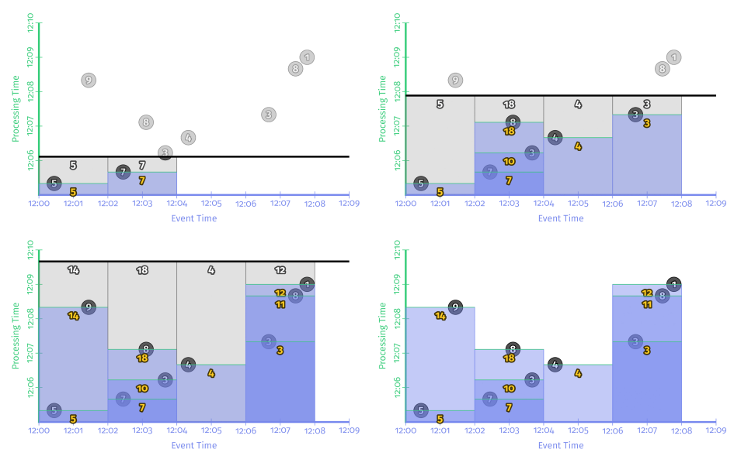
Streaming on unbounded data
Repeated update triggers
PCollection<KV<Team, Integer>> totals = input .apply(Window.into(FixedWindows.of(TWO_MINUTES)) .triggering(Repeatedly(AfterCount(1)))); .apply(Sum.integersPerKey());
PCollection<KV<Team, Integer>> totals = input .apply(Window.into(FixedWindows.of(TWO_MINUTES)) .triggering(Repeatedly(AlignedDelay(TWO_MINUTES))) .apply(Sum.integersPerKey());
PCollection<KV<Team, Integer>> totals = input .apply(Window.into(FixedWindows.of(TWO_MINUTES)) .triggering(Repeatedly(UnalignedDelay(TWO_MINUTES)) .apply(Sum.integersPerKey());
Notes:
Per-record triggering on a streaming engine：
ｗｒｉｔｅ ｔｏ ｔａｂｌｅ
Two-minute aligned delay triggers (i.e., microbatching)：
This sort of aligned delay trigger is effectively what you get from a microbatch streaming system like Spark Streaming
all updates happen at once Two-minute unaligned delay triggers

Slide 25
Streaming on unbounded data
Triggers
Watermarks
Watermarks are temporal notions of input completeness in the event-time domain.
Accumulation

Slide 26
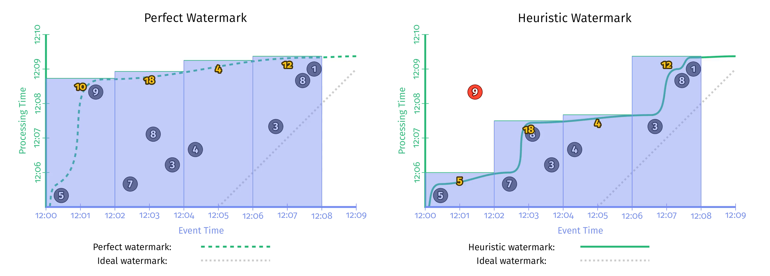
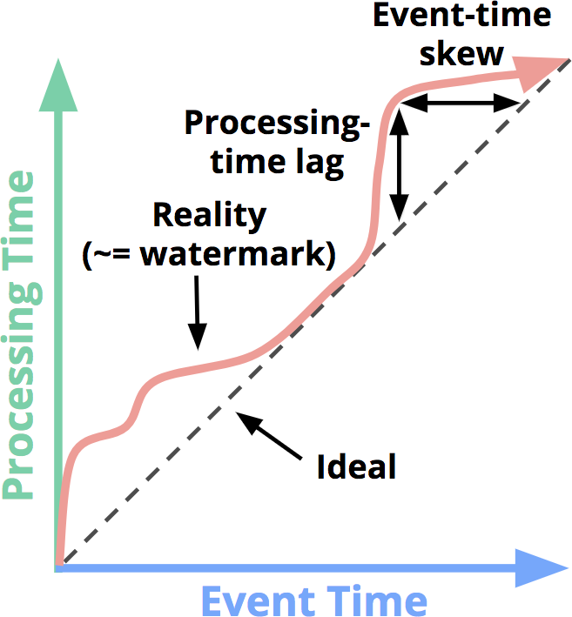
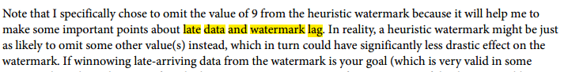
Streaming on unbounded data
Two types of Watermark
Perfect watermarks: all data are early or on time
Heuristic watermarks: late data
PCollection<KV<Team, Integer>> totals = input .apply(Window.into(FixedWindows.of(TWO_MINUTES)) .triggering(AfterWatermark())) .apply(Sum.integersPerKey());
Notes:
The perfect watermark, as you might expect, perfectly captures the event-time completeness of the pipeline as time progresses
Too slow:watermarks provide a very useful notion of completeness
Too fast: incorrect output value of 5 instead of 14.. correctness

Slide 27
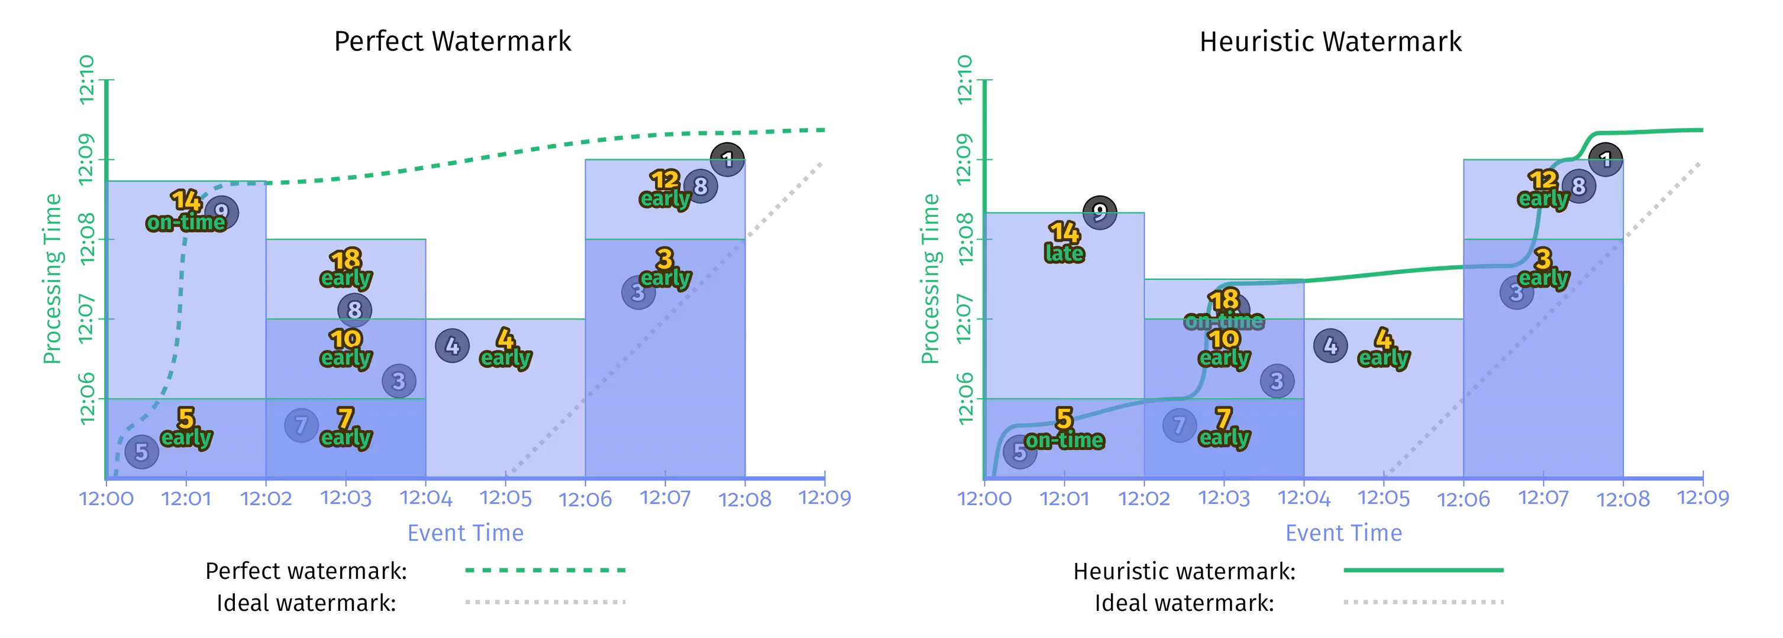
Streaming on unbounded data
Early trigger
repeated update trigger
too slow
on-time trigger
repeated update trigger
late trigger
repeated update trigger
too fast
PCollection<KV<Team, Integer>> totals = input .apply(Window.into(FixedWindows.of(TWO_MINUTES)) .triggering(AfterWatermark() .withEarlyFirings(AlignedDelay(ONE_MINUTE)) .withLateFirings(AfterCount(1)))) .apply(Sum.integersPerKey());
Notes:
Well, if repeated update triggers provide low-latency updates but no way to reason about completeness, and watermarks provide a notion of completeness but variable and possible high latency, why not combine their powers together?

Slide 28
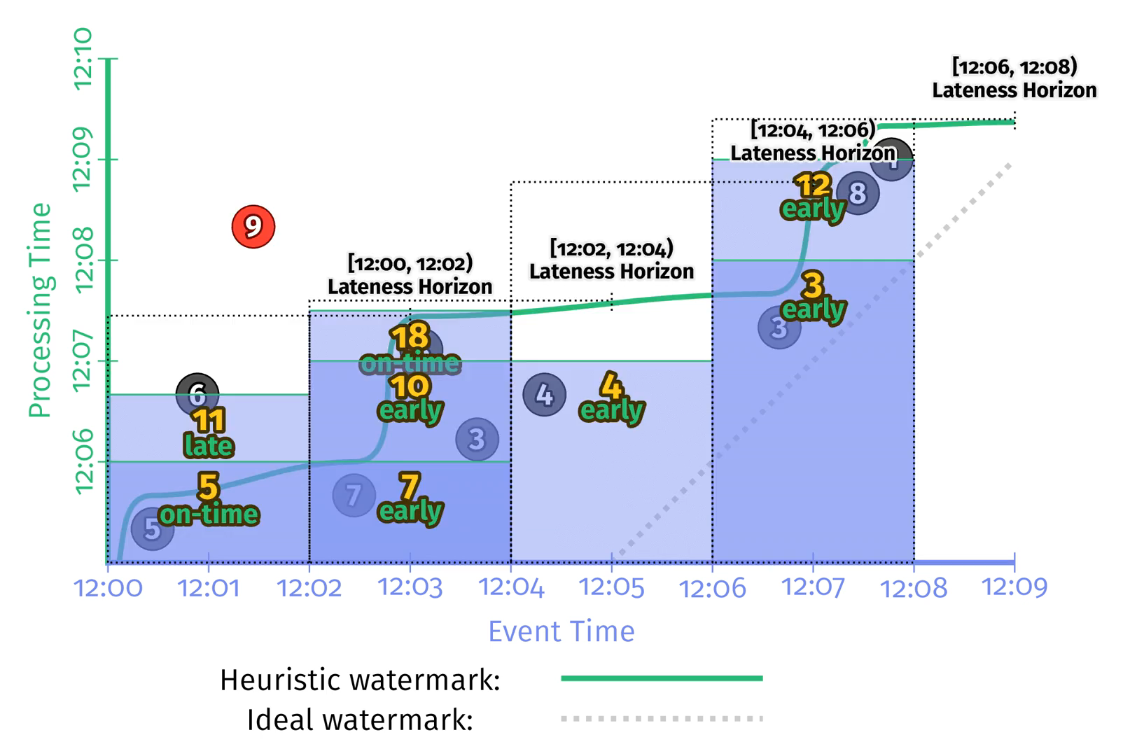
Streaming on unbounded data
Allowed Lateness
PCollection<KV<Team, Integer>> totals = input .apply(Window.into(FixedWindows.of(TWO_MINUTES)) .triggering( AfterWatermark() .withEarlyFirings(AlignedDelay(ONE_MINUTE)) .withLateFirings(AfterCount(1))) .withAllowedLateness(ONE_MINUTE)) .apply(Sum.integersPerKey());
Notes:
Well, if repeated update triggers provide low-latency updates but no way to reason about completeness, and watermarks provide a notion of completeness but variable and possible high latency, why not combine their powers together?

Slide 29
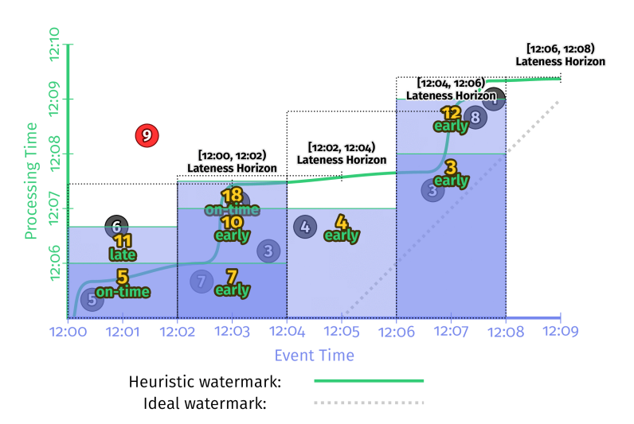
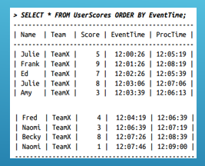
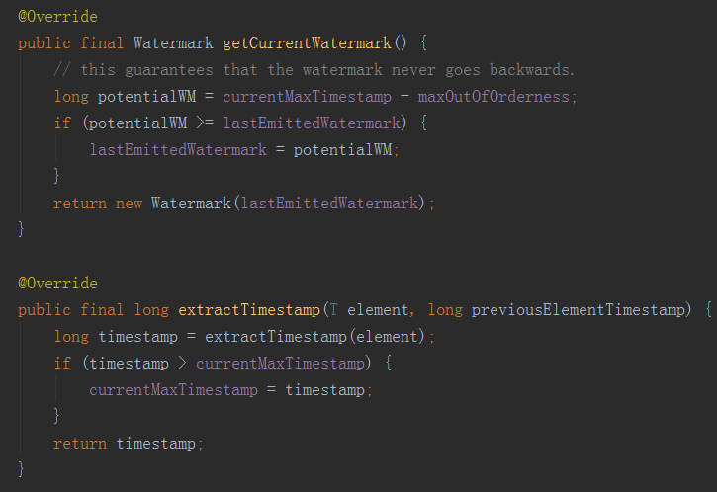
Streaming on unbounded data
Watermark calculate
单并行度

Slide 30
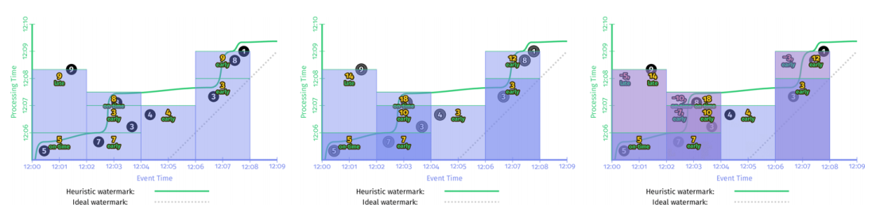
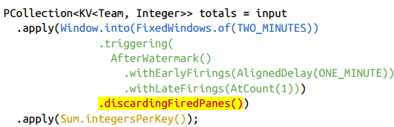
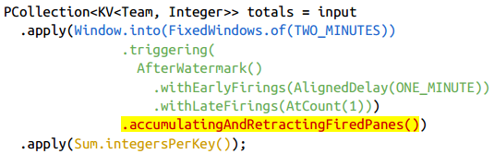
Streaming on unbounded data
Accumulation
Discarding
state discarded
Downstream sum accumulation itself
Accumulating
stored state
simply overwrite previous results
Accumulating and retracting
stored state and retracting previous reesult
“I previously told you the result was X, but I was wrong. Get rid of the X I told you last time, and replace it with Y.”
Notes:
Well, if repeated update triggers provide low-latency updates but no way to reason about completeness, and watermarks provide a notion of completeness but variable and possible high latency, why not combine their powers together?

Slide 31
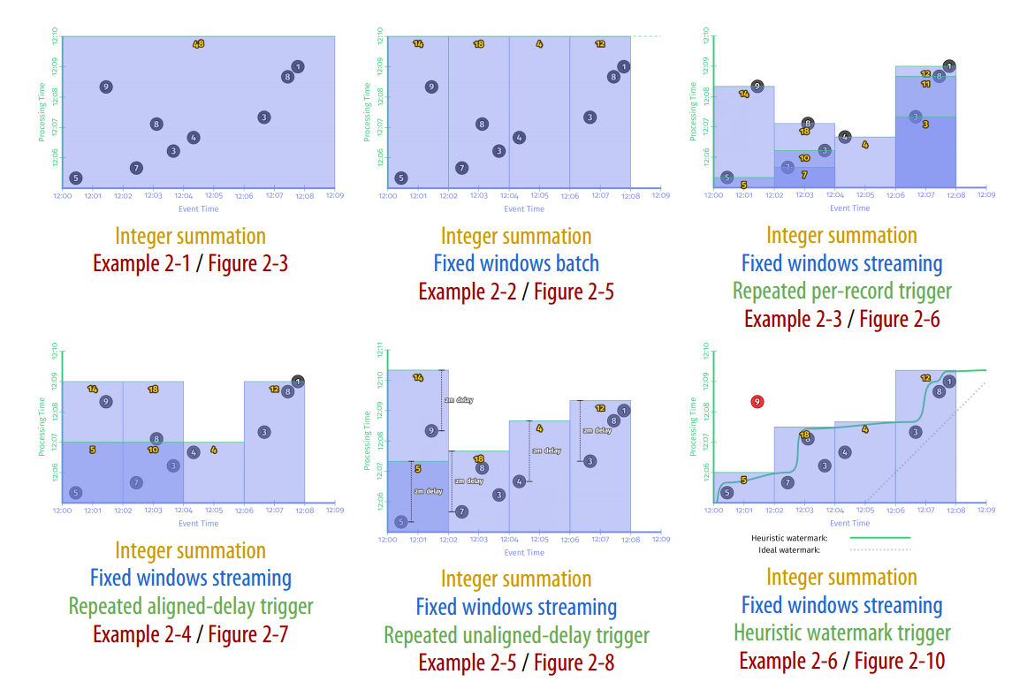
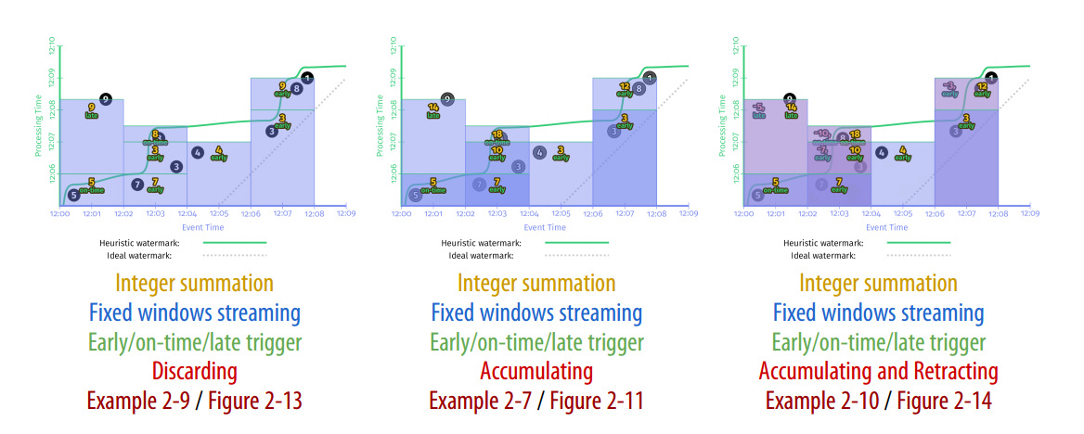
Summary
major concepts
Event time versus processing time
Windowing
Triggers
Watermarks
Accumulation
four questions
What results are calculated? (Trasformation)
Where in event time are results calculated? (windowing)
When in processing time are results materialized? (triggers,watermarks)
How do refinements of results relate?(accumulation)
Notes:
What 业务逻辑是什么? (ParDo, Combine) Where 在事件时间轴上对应哪里? (Windowing) When 何时输出结果？ (Triggering) How 如何更新结果？ (Accumulating)

Slide 32
Watermarks
Watermark definition
Watermark creation
Watermark Propagation
Processing-Time Watermarks
Summary

Slide 33
Watermark
how watermarks are created at the point of data ingress
how they propagate through a data processing pipeline
how they affect output timestamps
We also demonstrate how watermarks preserve the guarantees that are necessary for answering the questions of where in event-time data are processed and when it is materialized, while dealing with unbounded data.

Slide 34
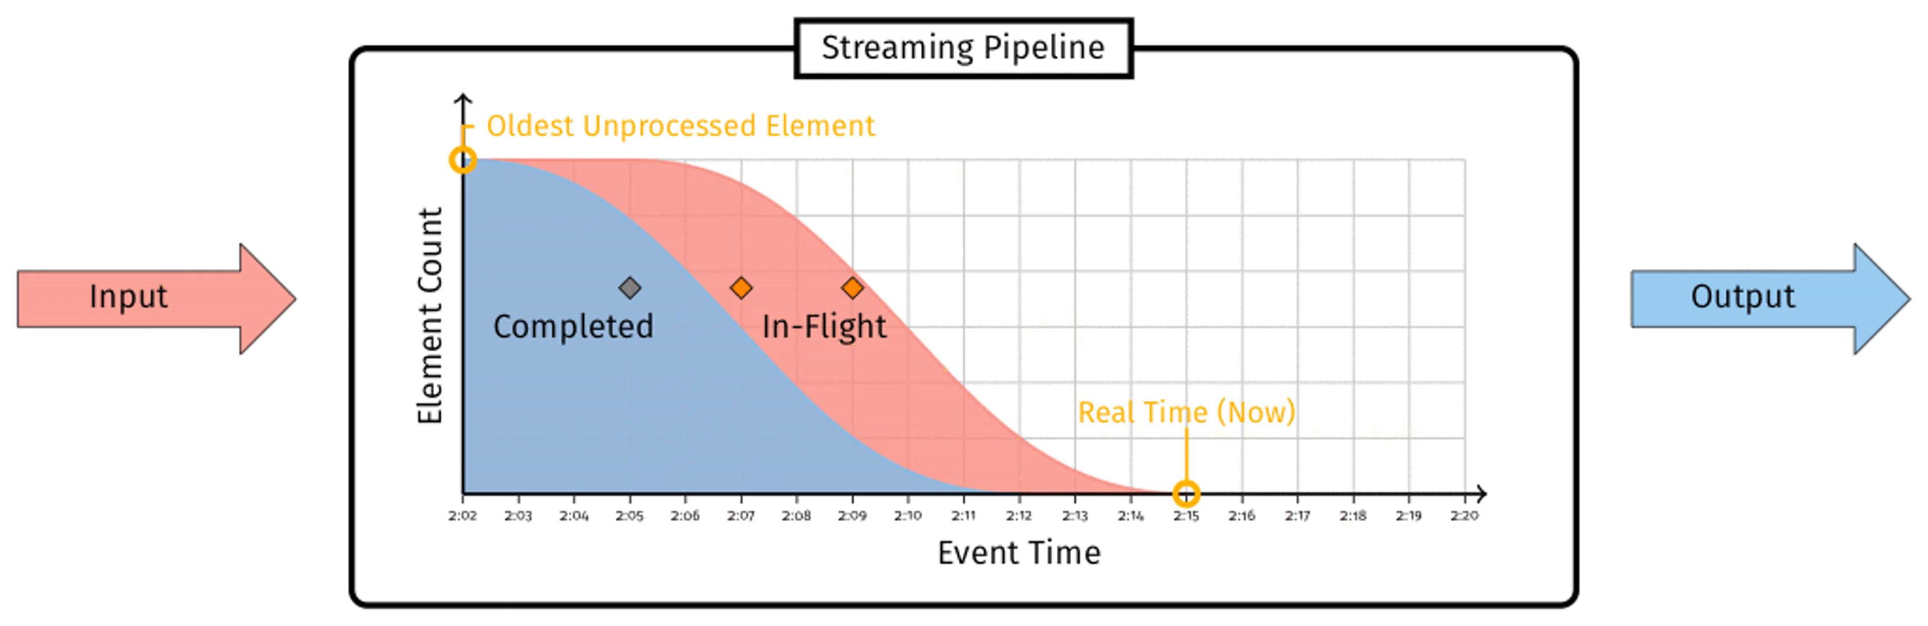
Watermark definition
when it is safe to call an event-time window closed？
each message has an associated logical event timestamp
define the watermark:
The watermark is a monotonically1 increasing timestamp of the oldest work not yet completed.
two fundamental properties
Completeness
Visibility
Notes:
Completeness If the watermark has advanced past some timestamp T, we are guaranteed by its monotonic property that no more processing will occur for on-time (nonlate data) events at or before T. Therefore, we can correctly emit any aggregations at or before T. In other words, the watermark allows us to know when it is correct to close a window. Visibility If a message is stuck in our pipeline for any reason, the watermark cannot advance. Furthermore, we will be able to find the source of the problem by exam‐ ining the message that is preventing the watermark from advancing.
Where do these watermarks come from?
assign a logical event timestamp to every message entering the pipeline from that source
Perfect Watermark Creation
Ingress timestamping
Static sets of time-ordered logs
Heuristic Watermark Creation
Dynamic sets of time-ordered logs
Google Cloud Pub/Sub

Slide 35
Watermark creation
Where do these watermarks come from?
assign a logical event timestamp to every message entering the pipeline from that source
Perfect Watermark Creation
Ingress timestamping
Static sets of time-ordered logs
Heuristic Watermark Creation
Dynamic sets of time-ordered logs
Google Cloud Pub/Sub

Slide 36
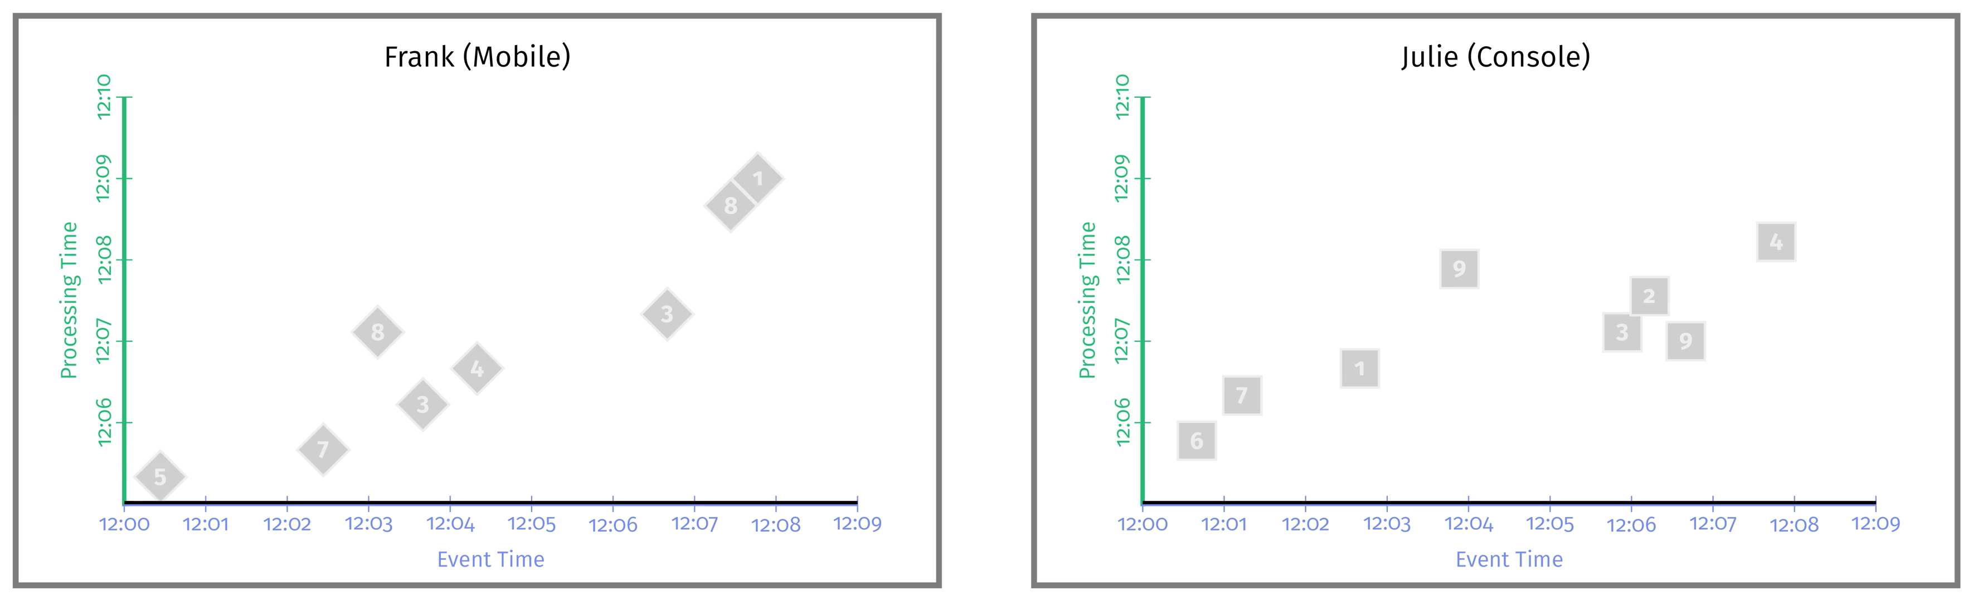
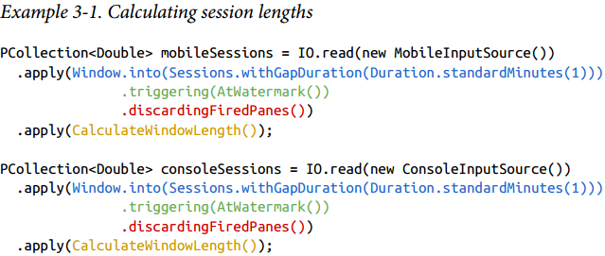
Watermark Propagation
watermarks at the boundaries of stages
input watermark：captures the progress of everything upstream of that stage
output watermark：captures the progress of the stage itself
Example
Notes:
So far, we have considered only the watermark for the inputs within the context of a single operation or stage Understanding how watermarks propagate across independent stages is important in understanding how they affect the pipeline as a whole and the observed latency of its results.
输入watermark（An input watermark）：捕捉上游各阶段数据处理进度。对源头算子，input watermark是个特殊的function，对进入的数据产生watermark。对非源头算子，input watermark是上游stage中，所有shard/partition/instance产生的最小的watermark
输出watermark（An output watermark）：捕捉本stage的数据进度，实质上指本stage中，所有input watermark的最小值，和本stage中所有非late event的数据的event time。比如，该stage中，被缓存起来等待做聚合的数据等。

Slide 37
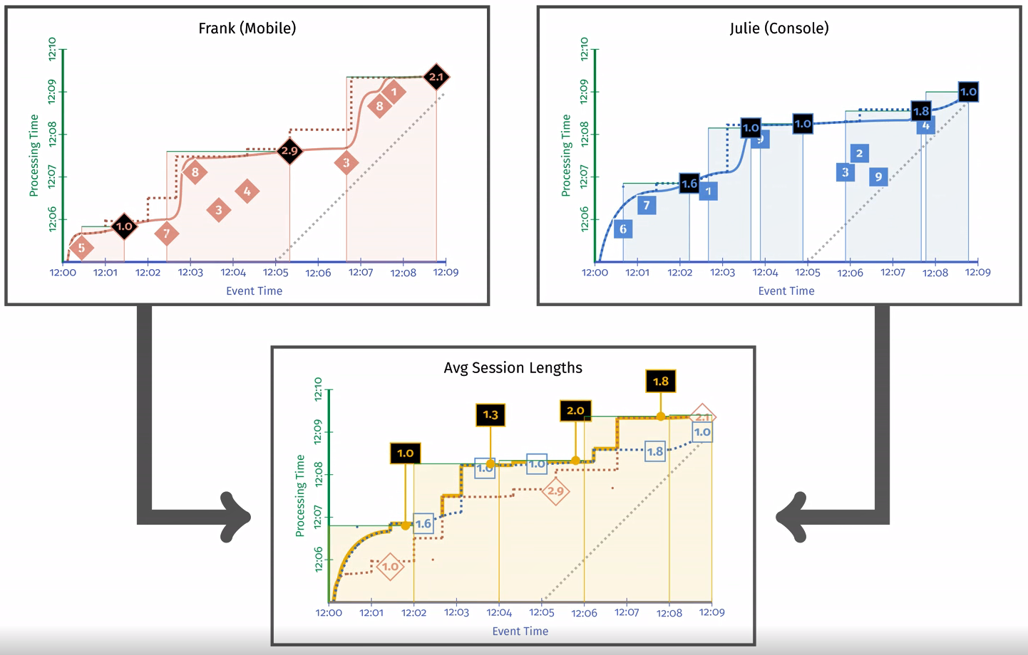
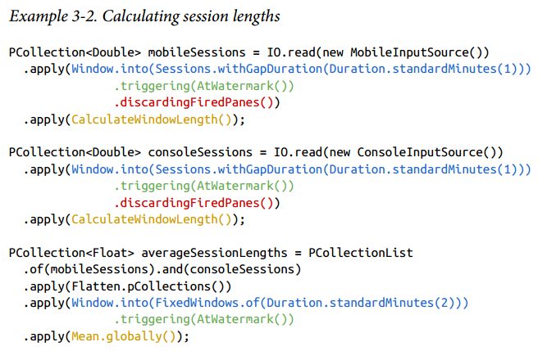
Watermark Propagation

Slide 38
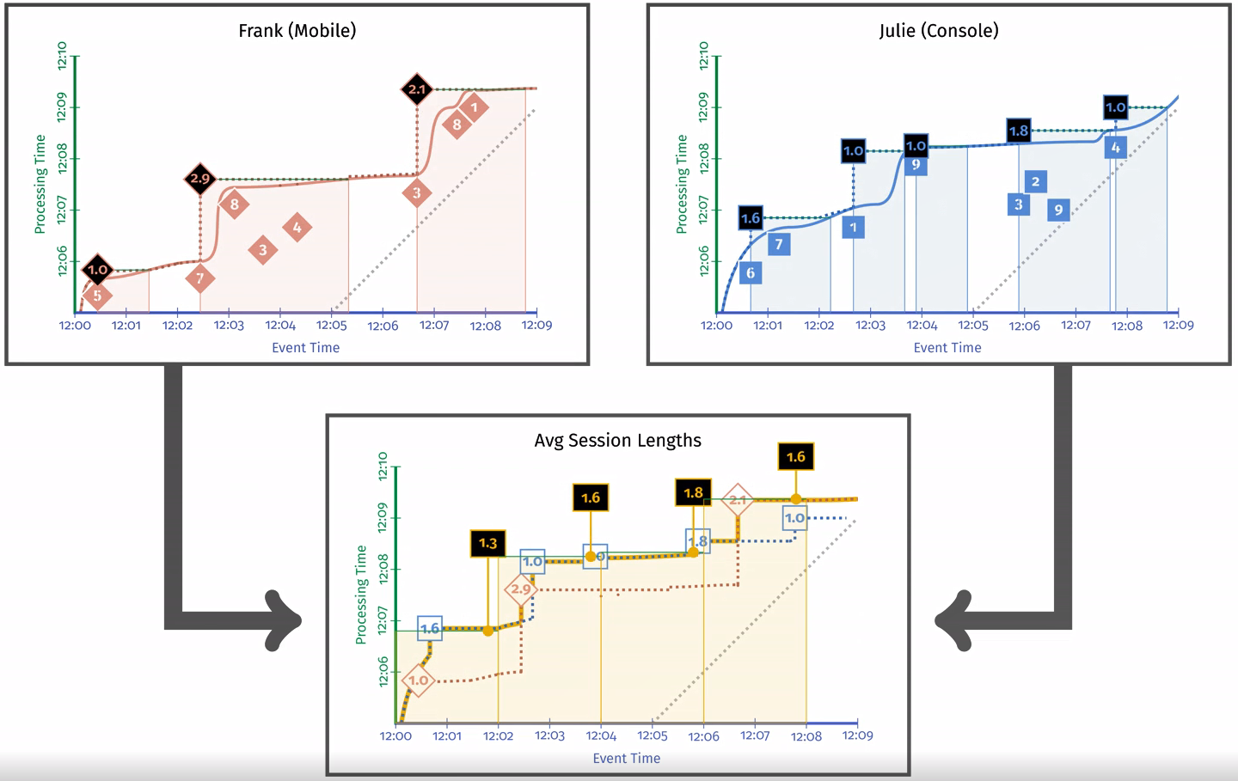
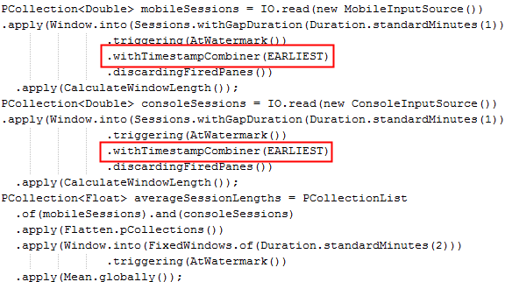
Watermark Propagation
Window end timestamp
Watermark Propagation choices
End of the window
Timestamp offist nonlate element
Timestamp of a specifi element
Notes:
窗口结束时间：将窗口结束时间作为这个窗口输出数据的时间戳。这种方式系统的性能最好。
窗口中第一个非迟到数据的时间戳：用窗口中第一个非late event的数据的时间戳，作为窗口所有输出数据的时间戳是一种非常保守的方式，并会对系统性能有一定影响
用窗口中某个元素的时间戳：在某种用例中，比如一个查询流join一个点击流，有时希望用查询流的时间戳做watermark，有时又希望用点击流的时间戳做watermark。
watermark delay：第二种方式watermark明显比第一中方式慢，因为只有窗口结束，watermark才能向前推进
语义差别：watermark被定为第一个非late event数据的时间戳，在本例子中，同一个session可能落在不同的固定窗口中。这两种方式没有谁对谁错，但是在用之前，需要明确知道内部原理才能正确使用watermark

Slide 39
Processing-Time Watermarks
Why？
我们无法区分一个小时前快速且无延迟处理数据的系统和一个试图处理实时数据的系统，并且在执行此操作时延迟了一个小时
When？
a stuck message delivery from one stage to another
a stuck I/O call to read state or external data
an exception while processing
What？
provides a notion of processing delay sep‐arate from the data delay
Where？
Chapter 5. Exactly-Once and Side Effects

Slide 40
Summary
我们探讨了如何使用消息的event-time来给出流处理系统中进度的可靠定义
We looked at how watermarks are created at the sources
Watermark Propagation
Processing-Time Watermarks
We can use windowing and triggering to answer more complex queries

Slide 41
Advanced Windowing
Processing-time windows
Session windows
Customer windows

Slide 42
Exactly-Once and SideEects
Exactly Once
Shuffle
Source
Sink
Beam vs Flink vs Spark on Exactly Once
Beam -》独立节点中心存储
Spark -》checkpoint
Flink -》snapshot

Slide 43
Links
Streaming system.pdf
https://cloud.google.com/dataflow/model/triggers?hl=zh-Cn
https://juejin.im/post/5bf95810e51d452d705fef33
https://beam.apache.org/documentation/programming-guide/#triggers
https://yq.aliyun.com/articles/682873

Slide 44
END

